Slide 1


Visitors management: No-Reesa Voice Translator

Slide 2
Table of content
Introduction
No-Reesa
VISITORS MANAGEMENT :
Conclusion
1
2
3
4

Slide 3
Introduction
Today, uneducated retailers often encounter difficulties communicating with foreign partners due to language barriers. The No-Reesa project offers an innovative solution: a mobile application capable of translating Mooré-English voice exchanges in real time, facilitating reception, orientation, and communication with visitors, while increasing efficiency and inclusion in commercial interactions.

Slide 4
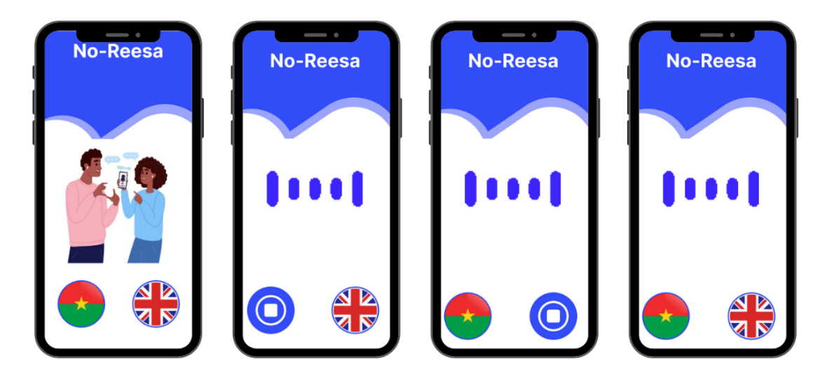
No Reesa
No Reesa means interpreter in our local language(Moore)
The No-Reesa project is a Mooré-English voice translation mobile application powered by artificial intelligence. It aims to facilitate communication between uneducated traders and their business partners by eliminating language barriers. The team collected its own data, including basic Mooré greetings, to address the scarcity of resources in local languages.

Slide 5
VISITORS MANAGEMENT :
NO-REESA
The No-Reesa project enables efficient visitor management in retail environments by eliminating language barriers between non-school-educated retailers and their foreign partners. The mobile application translates Mooré-English voice exchanges in real time, facilitating reception, orientation, and communication with visitors.

Slide 6
Conclusion
By facilitating communication between non-schooled traders and foreign visitors, No-Reesa improves the visitor experience, optimizes the management of commercial interactions and contributes to the development of local language resources, thus paving the way for greater inclusion and new opportunities for trade.

